Slide 1
INTERNAL GRADE ASSESSMENT
MADE BY : A26 PRIYANSHU SAHOO
A46 PRIYANSHU TANDON
a54 RASHUM KAUSHIK
a56 LEELADHAR DHRUW

Slide 2

ABSTRACT
The internet revolution brought a lot of opportunities in the education sector. The manual method of marking all individuals’ students and storing their report consumes a lot of time of the faculties and makes a hectic work load on them.
The report consists of the working and result of the “INTERNAL GRADE ASSESSMENT SYSTEM”. Internal grade assessment system is a web application. The system is developed for the calculation of internal marks of every individual student. This system has been created to store the internal marks and the attendance. Hence, the system will calculate the input data of the students, based on the criteria given by the college. At last, the system will display the result.

Slide 3
Roadmap
STAGE 01
PROJECT IDEA AND OVERVIEW
LEARNING REQUIRED PROGRAMMING LANGUAGES (HTML,CSS,JS,
STAGE 03
CREATION OF BASIC WEB PAGES
STAGE 02
STAGE 04
STAGE 05
CREATION OF WEBSITE AND HOSTING IT
DEPLOYMENT OF WEBSITE,CONTENT REVIEW
MongoDB)

Slide 4
TABLE OF CONTENT
INTRODUCTION
WORKING CONCEPT
TECHNOLOGIES USED
SCOPE
WEBSITE VISIT
CONCLUSION
FUTURE SCOPE

Slide 5

Introduction The aim of this project is to computerized the existing manual system and help the teachers to save their valuable time and important data. Evaluating internal marks is time consuming as well as requires more human effort. This system provides a comprehensive solution to manage the internal grade evaluation. In this project we have create a system that will store all student details and the marks of the each subjects and its attendance and calculate the internal marks of the students, based on the criteria given by the college. Faculty can login with their password and username . it displays the internal marks subject wise in tabular form. Faculty can add the details, marks for the subject they can update the marks while entering the data; they can add manually data in the system.

Slide 6

WORKING CONCEPT
Teacher Login: It able the teachers to login to system with a valid email id and password. If a teacher is successfully login to system, he/she will have access to following pages:
Dashboard: Teacher will be able to access the dashboard where they will get option to move to the internal grade assessment system’s Home Page.
Preference Selection: Which able the teacher to select branch, semester, subject acc. To their preference.
Internal Grade Analysis: Which able the teacher to insert the internal marks and get the desired report in the form of pdf.

Slide 7
technologies used
DEVLOPMENT-END SOFTWARE REQUIRMENT
FRONT-END | HTML CSS
BACK-END | JAVASCRIPT
DATABASE | MongoDB
USER-END SOFTWARE REQUIRMENT
WEB-BROWSER | GOOGLE CHROME OR OTHER USED BROWSER
OPERATING SYSTEM | WINDOWS 8 OR ABOVE

Slide 8
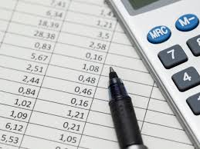
SCOPE
1. Calculation of Internal Grade effortlessly.
2. Safe and secured data.
3. Reduces burden on Teachers.
4. Use of modern technologies.

Slide 9
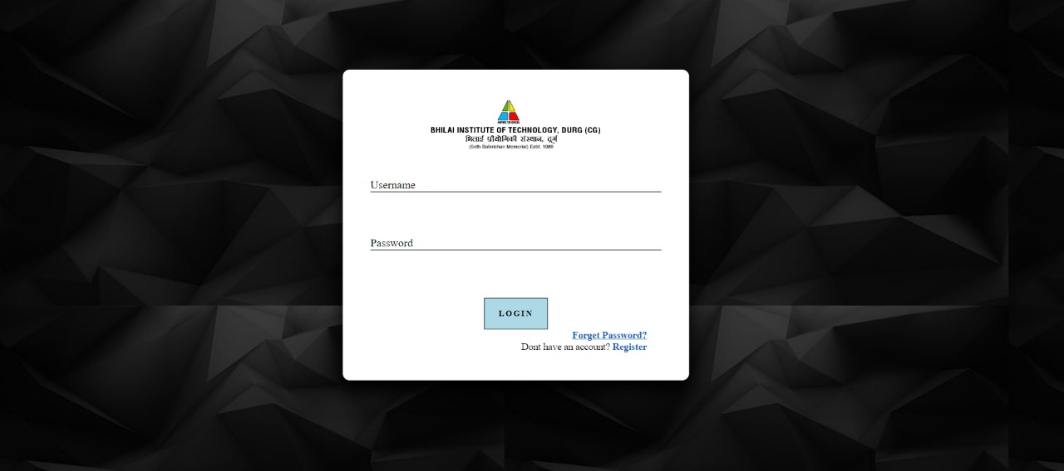
WEBSITE VISIT
LOGIN PAGE
This is the basic look of login page from where the teacher’s will be able to login to use the “INTENAL GRADE ASSESSMENT SYSTEM”

Slide 10
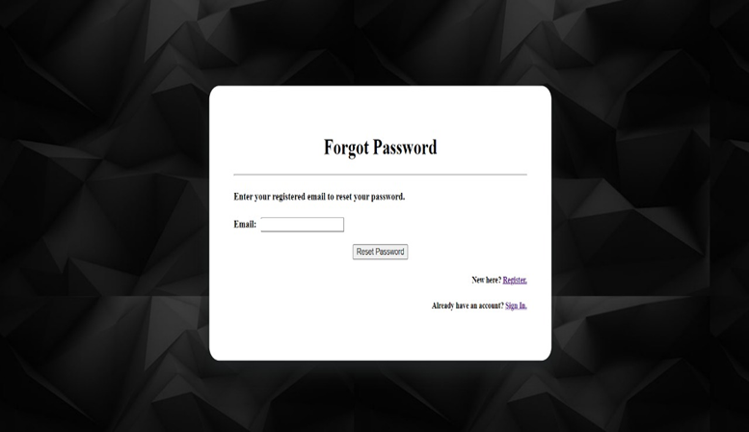
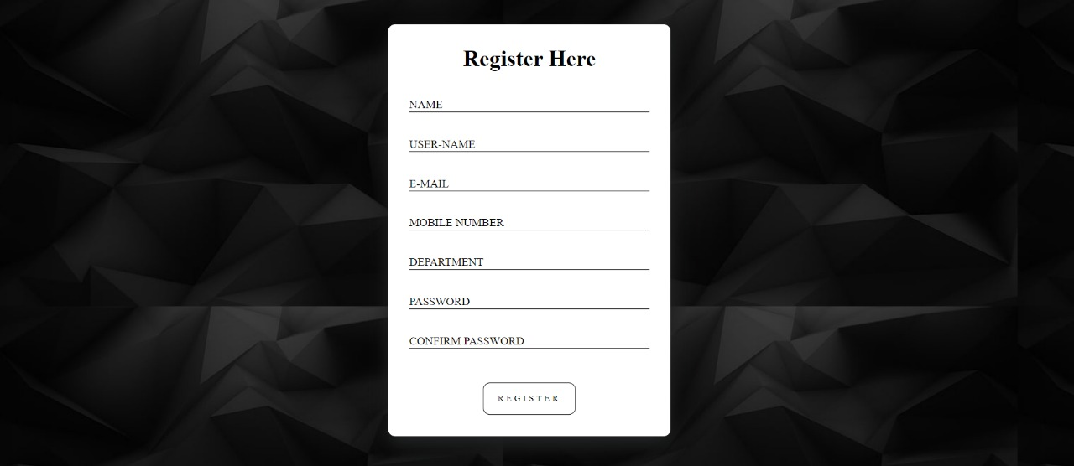
FORGET PASSWORD PAGE: On the login page, we have provided a forget password link where the teacher’s if require they can reset their password.
REGISTRATION PAGE: On login page, we have provided registration page link, INORDER to use the “INTENAL GRADE ASSESSMENT SYSTEM”, teachers have to FIRST register themselves.

Slide 11

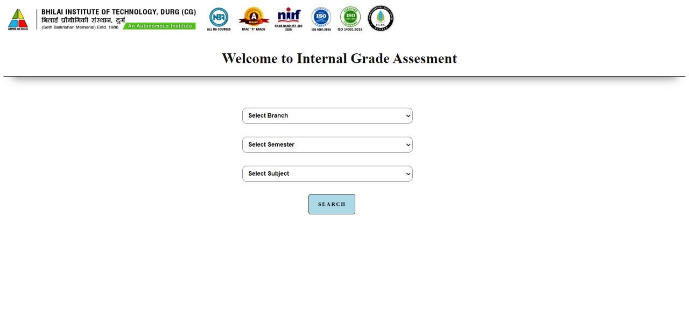
DASHBOARD:
After teacher’s login, they will be redirected to the dashboard. From where they can select the option to go to the home page of the “INTERNAL GRADE ASSESMENT SYSTEM”
HOME PAGE:
After selection from the dashboard, they will be redirected to the home page of “INTERNAL GRADE ASSESSMENT SYSTEM”. On this page, teachers can go to their respective stream

Slide 12
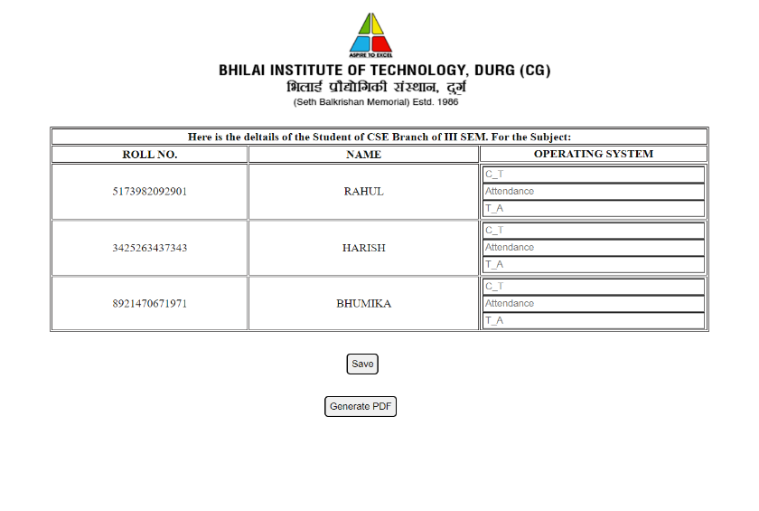
REPORT OF STUDENT: After the teacher select their preference’s, then they are redirected to the student report page, where they can input the student’s marks where they will get the calculated assessment marks and can generate a pdf format file of the marksheet.

Slide 13

CONCLUSION
The goal of the system is achieved and difficulties are solved. The project is built such that it is user friendly. Analysis of the scoring system it shows by the result of individual subject and final result also displayed .The project can be easily used in college for college result analysis of student. It reduces time which required for manual calculation. This system helps to calculate result fast so it optimizes the manpower. This result analysis application is useful for the examination control section to maintain the student’s marks and analyze the academic performances. This application allows the examination control department admin to analyse the academic performance of the students and allows to print/ download the student details, subject details, marks details and marks statements.

Slide 14

FUTURE SCOPE
With tremendous changes in the educational sector, the use of online assessment has become more popular and widely adopted and our project being of the same category can serve as one of the good alternatives for traditional assessment methods.
With time, changes can be made in the website as per the requirement of our teacher’s we can provide them more facility which can be accessible through the dashboard.

